Slide 1
ML - Capstone project
Laptop Price Prediction
Santhosh Kumar Ciliveru(S7946)

Slide 2
Problem Statement
The goal of this project is to develop a predictive model that can accurately estimate the price of laptops based on various features such as brand, specifications, and other relevant attributes. This model will be valuable for consumers looking to make informed purchasing decisions and for businesses aiming to price their products competitively in the market

Slide 3
Data Preprocessing
I handled the 30 null values in the dataset and removed two unnecessary columns labeled as "Unnamed : 0", Unnamed : 0.1. This data cleaning step ensures the dataset is ready for further analysis by eliminating missing data and irrelevant columns, improving the overall quality and usability of the data.
I identified 29 duplicate values in the dataset and removed them using df.duplicated().sum(). This step ensures that the dataset is free of redundant entries, improving data integrity for further analysis.

Slide 4
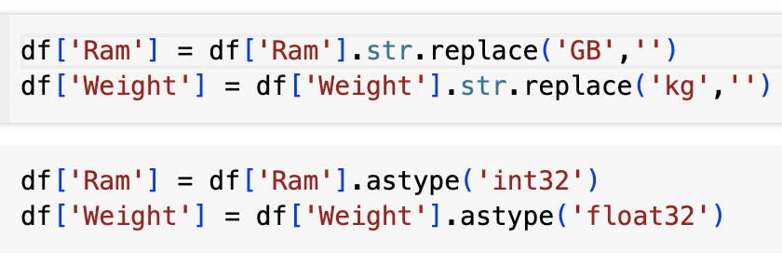
Data Preprocessing
I converted the 'Ram' and 'Weight' columns to 'int' and 'float' types, respectively, by removing the "GB" and "kg" strings. This step facilitates data extraction and ensures these columns are in the correct format for analysis

Slide 5
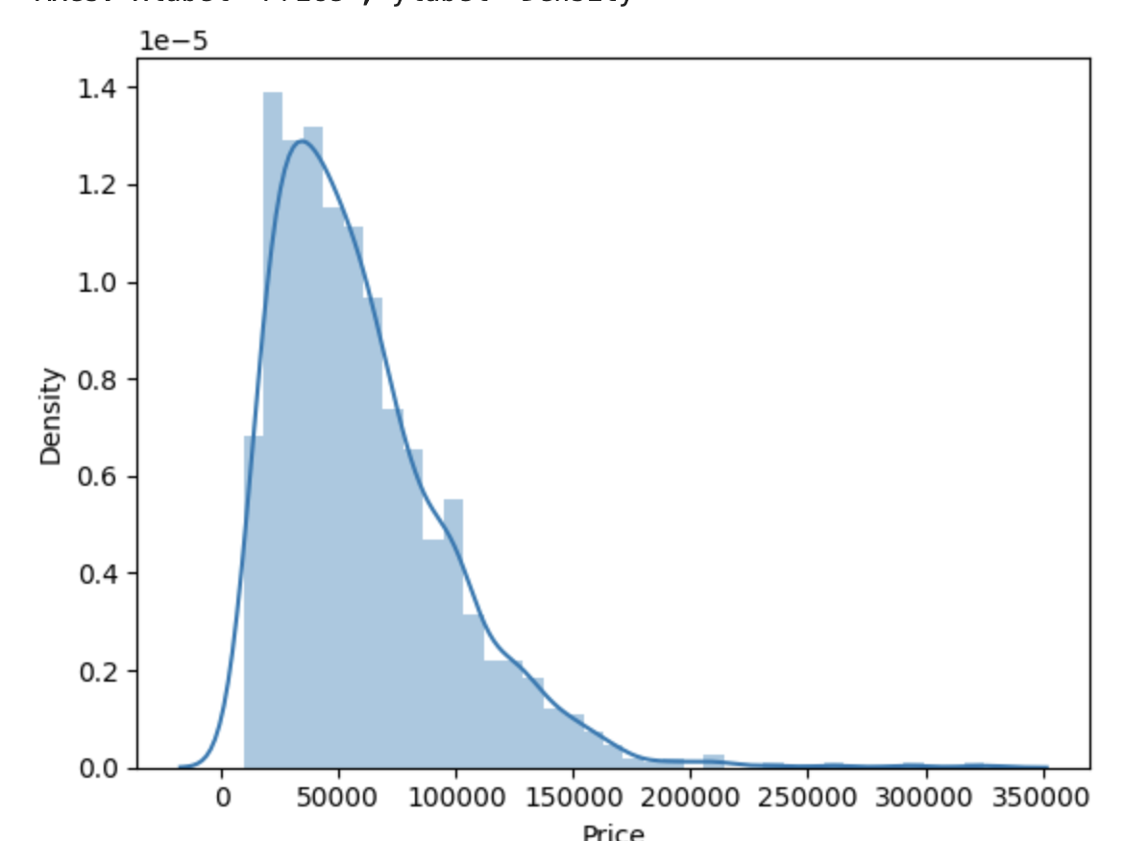
Exploratory Data Analysis
The graph reveals that the majority of laptops fall within
the price range of 30,000 to 100,000. This indicates
that this price bracket is the most prevalent in the dataset,
suggesting that most consumers or retailers set laptop
prices within this range

Slide 6
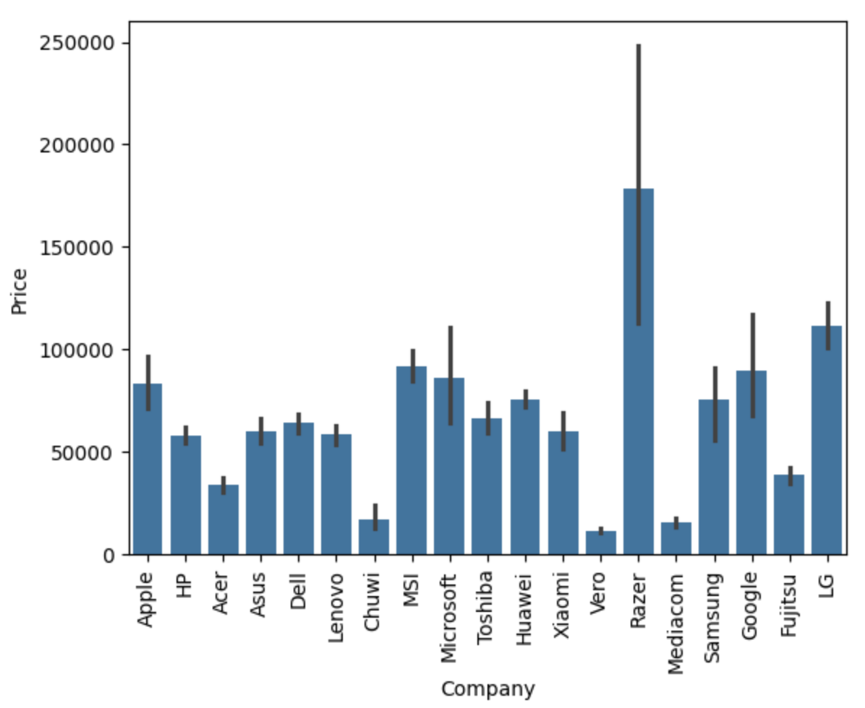
Exploratory Data Analysis
Razer laptops consistently have higher
prices than other brands, it suggests
that Razer positions itself as premium
option in the market.

Slide 7
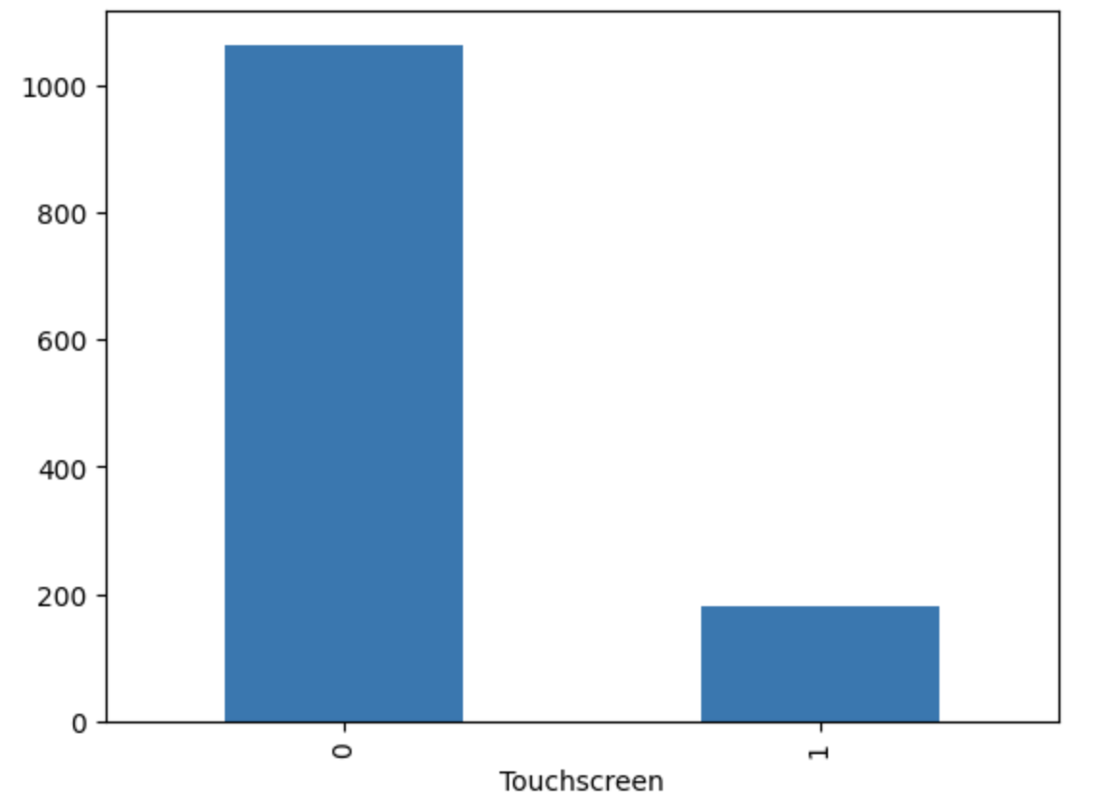
Exploratory Data Analysis
Non-touch screen laptops are typically more
popular in terms of sales volume compared
to touch screen laptops, Touch screens are
Priced high

Slide 8
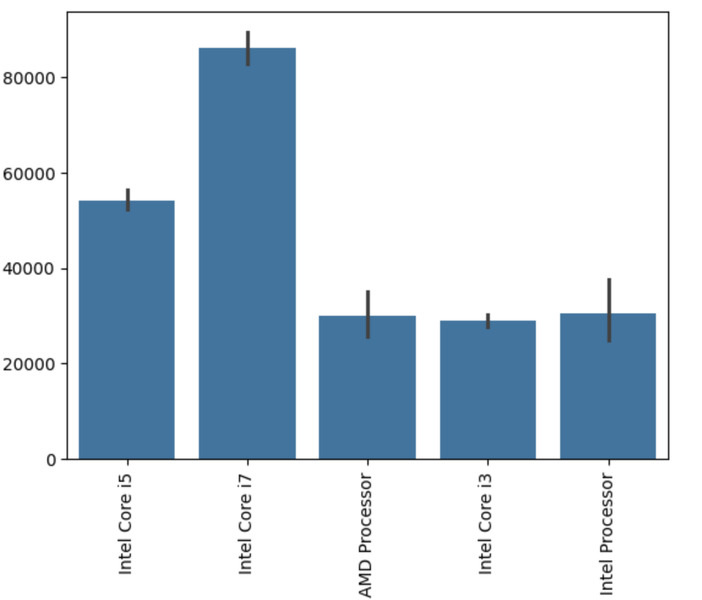
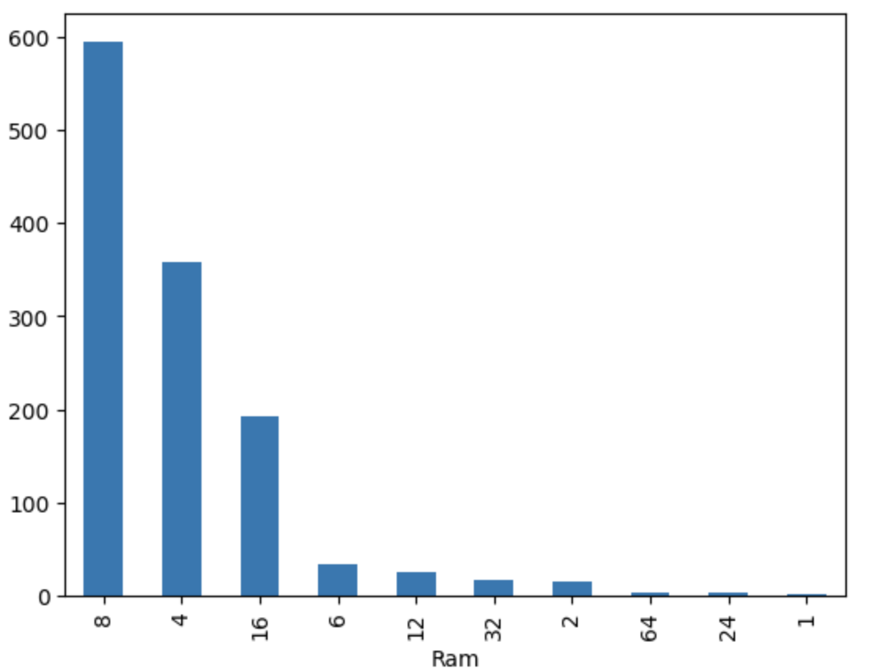
Exploratory Data Analysis

Slide 9
Model Development
During model development, I employed a variety of algorithms including linear regression, random forest regressor, gradient boosting, and XGBoost. This approach allowed for comprehensive exploration of different modeling techniques to identify the most effective strategy for predicting laptop prices accurately.

Slide 10
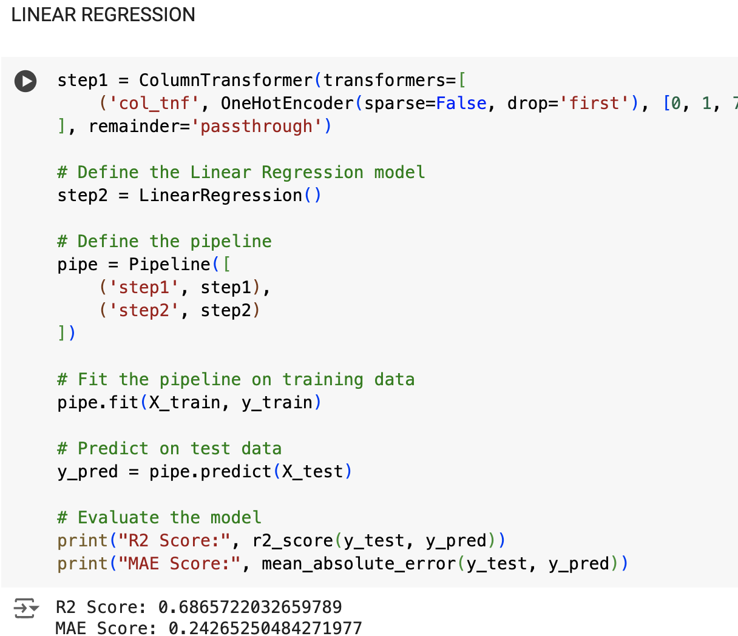
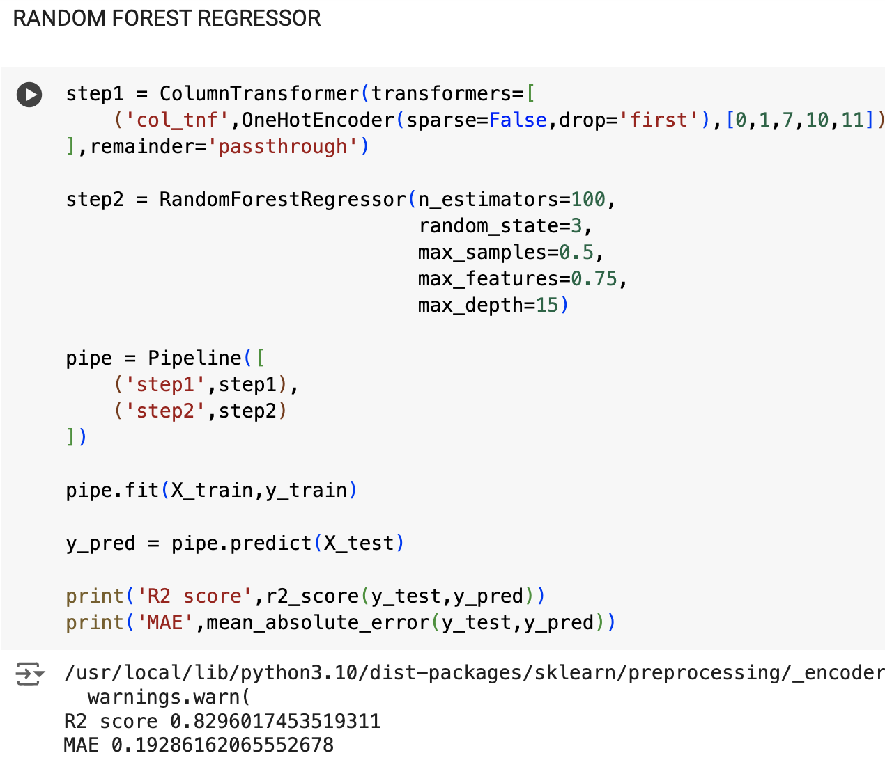
Model Development

Slide 11
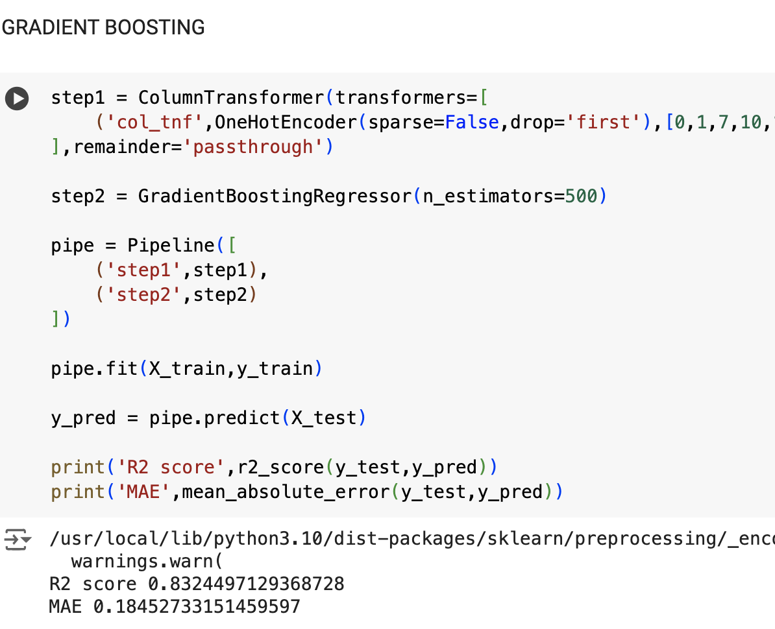
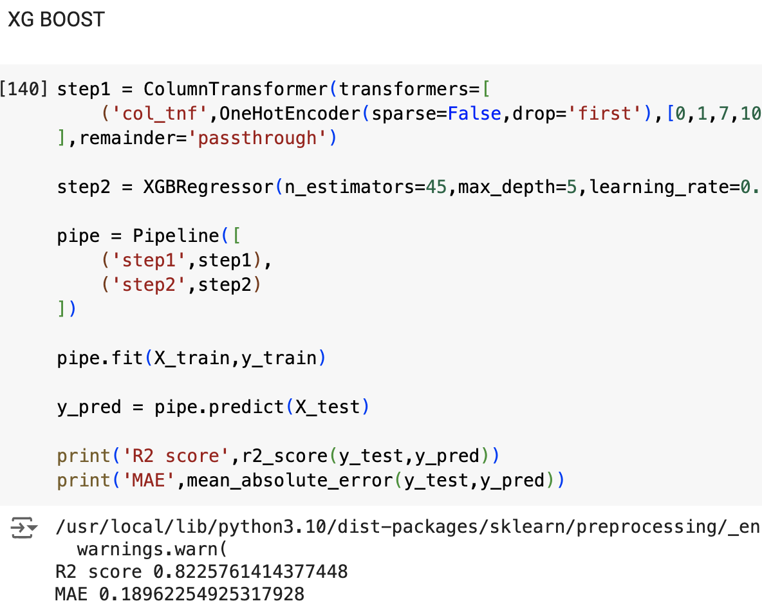
Model Development

Slide 12








Model evaluation

Slide 13
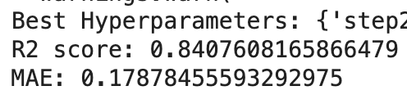
Model Optimization
Following hyperparameter tuning with RandomizedSearchCV, the gradient boosting model achieves a higher R2 score, indicating improved performance in capturing variance and making more accurate predictions

Slide 14
Conclusion
In conclusion, the laptop price prediction project successfully developed predictive models using various Machine Learning algorithms and optimized the performance through hyperparameter tuning.The model provide valuable insights for consumers and businesses in making informed decisions in the dynamic laptop market.

Slide 15


